Slide 1
The Singleton Design Pattern
Bejenaru Dan, Rapeanu George, Cantor Alex

Slide 2
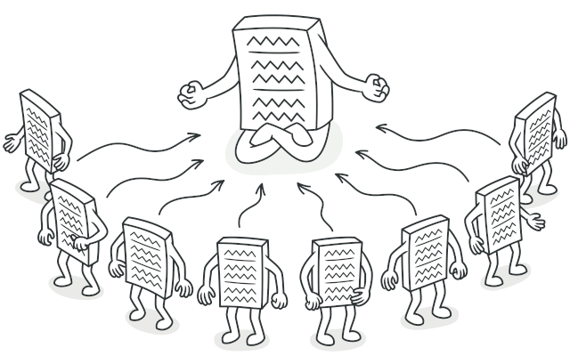
Source: “Singleton”. Refactoring Guru, 2024, https://refactoring.guru/design-patterns/singleton

Slide 3
Singleton
creational design pattern
allows defining a class which has only one instance
global access point to the instance

Slide 4
What it’s trying to solve?

Slide 5
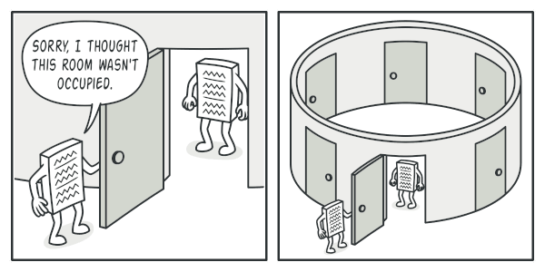
Source: “Singleton”. Refactoring Guru, 2024, https://refactoring.guru/design-patterns/singleton

Slide 6
Ensure that a class has just a single instance
The most common reason for this is to control access to some shared resource—for example, a database or a file.
Source: “Singleton”. Refactoring Guru, 2024, https://refactoring.guru/design-patterns/singleton

Slide 7
Provide a global access point to that instance
Just like a global variable, the Singleton pattern lets you access some object from anywhere in the program. However, it also protects that instance from being overwritten by other code.
Source: “Singleton”. Refactoring Guru, 2024, https://refactoring.guru/design-patterns/singleton

Slide 8
How to?

Slide 9
1. Make the default constructor private
It prevents other objects from using the new operator with the Singleton class.
Source: “Singleton”. Refactoring Guru, 2024, https://refactoring.guru/design-patterns/singleton

Slide 10
2. Create a static creation method that acts as a constructor
Under the hood, this method calls the private constructor to create an object and saves it in a static field. All following calls to this method return the cached object.
Source: “Singleton”. Refactoring Guru, 2024, https://refactoring.guru/design-patterns/singleton

Slide 11

Real World Analogy
The government is a good example of the Singleton pattern.
A country can have only one official government.
https://www.scottgustafson.com/parliament-of-owls

Slide 12
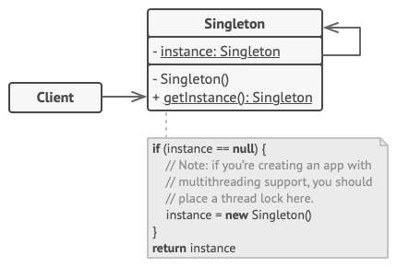
Structure
The Singleton’s constructor should be hidden from the client code. Calling the getInstance method should be the only way of getting the Singleton object.
Source: “Singleton”. Refactoring Guru, 2024, https://refactoring.guru/design-patterns/singleton

Slide 13
Example 1 - Godot Game Engine

Slide 14
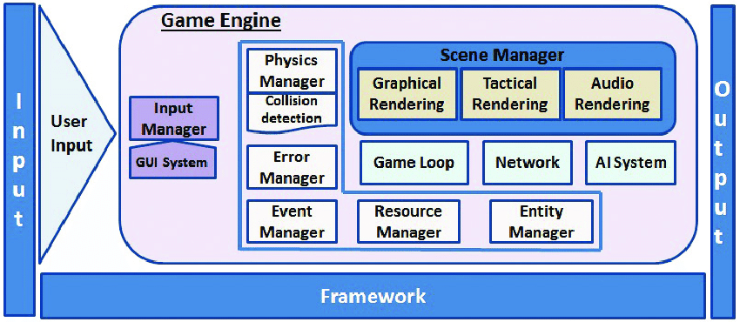
What is a Game Engine?
A framework, designed to abstract away hardware details, specialized for game development
Provides implementations for commonly used subsystems, such as a Physics Manager
https://www.researchgate.net/figure/Detailed-game-engine-architecture_fig2_323179176

Slide 15

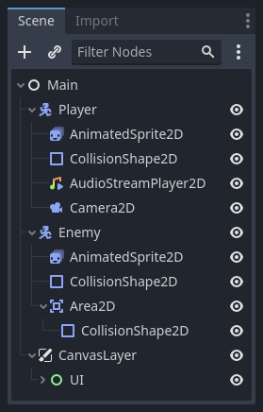
The Godot Game Engine
Godot is an open-source general-purpose 2D and 3D game engine designed to support all sorts of projects.
Developers can code in established programming languages, such as C++ and C#, or GDScript, a godot specific language.
Godot embraces object-oriented design at its core with its flexible scene system and Node hierarchy.
Godot logo
Nodes and Scenes system

Slide 16
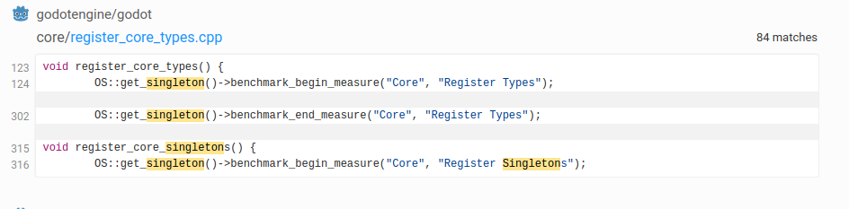
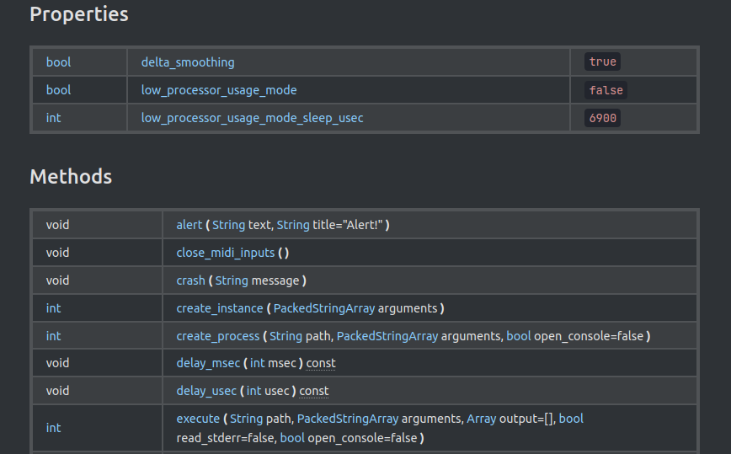
The Godot Game Engine - OS Singleton
Provides access to common operating system functionalities.
A single instance passed across the entire application, with multiple implementations for different architectures.

Slide 17
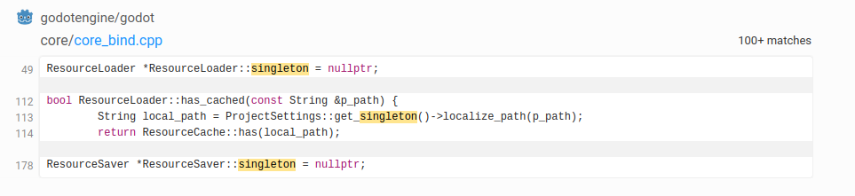
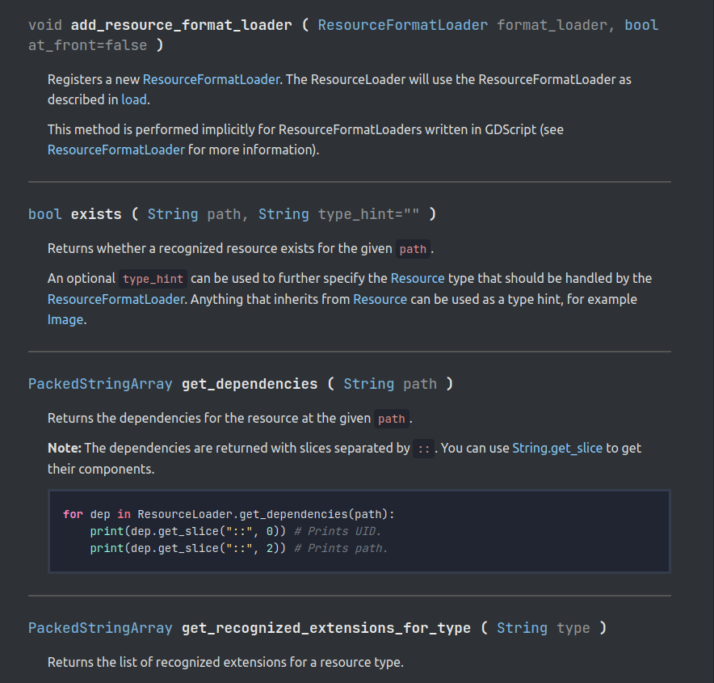
The Godot Game Engine - ResourceLoader & Saver Singleton
A singleton for loading/saving resource files.
Provides an abstraction over filesystems, with multiple implementations for each.
Supports different types of resources(textures, sounds, scripts).

Slide 18
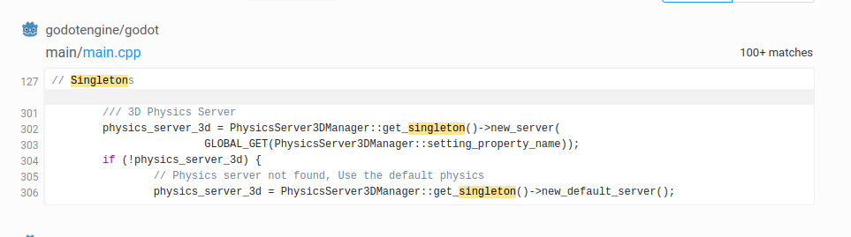
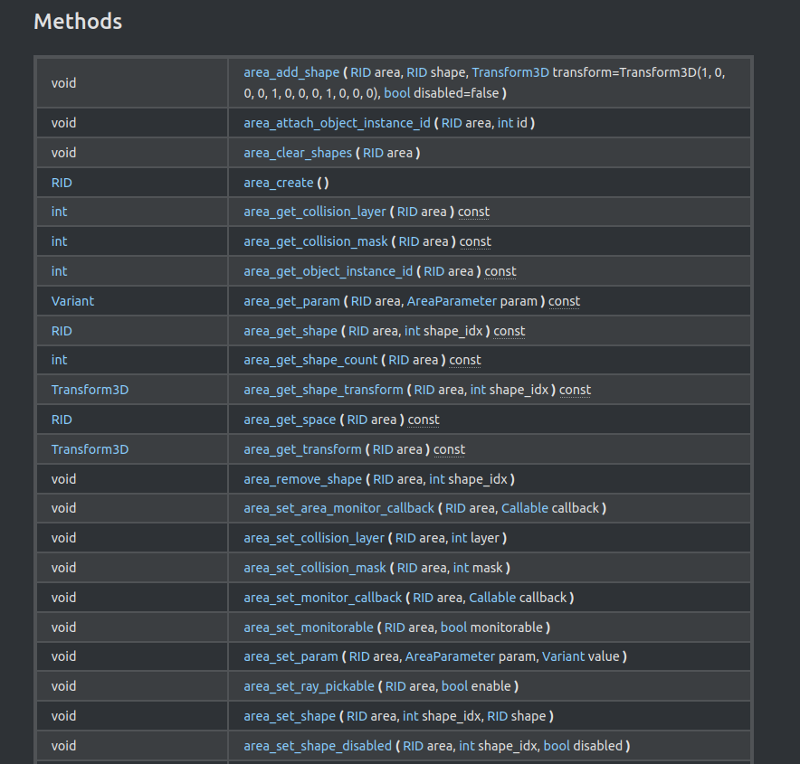
The Godot Game Engine - Physics3DManager Singleton
A singleton for managing PhysicsServer3D implementations.
Manages and simulates physics interactions
Integrated with the node/scene system

Slide 19
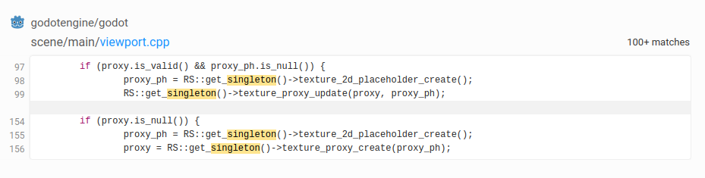
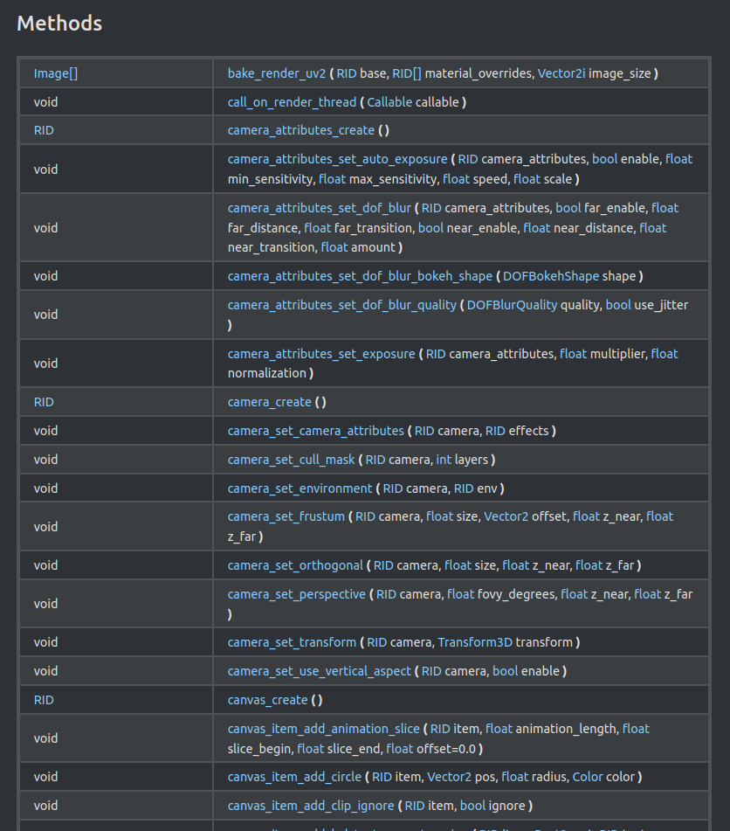
The Godot Game Engine - RenderingServer Singleton
Singleton that manages client-side rendering tasks.
Offers granular control over rendering tasks, bypassing the node/scene system.

Slide 20
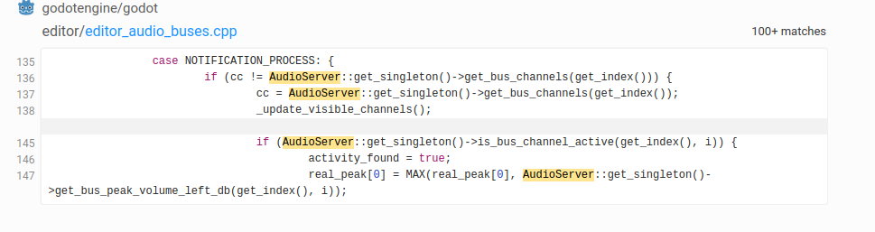
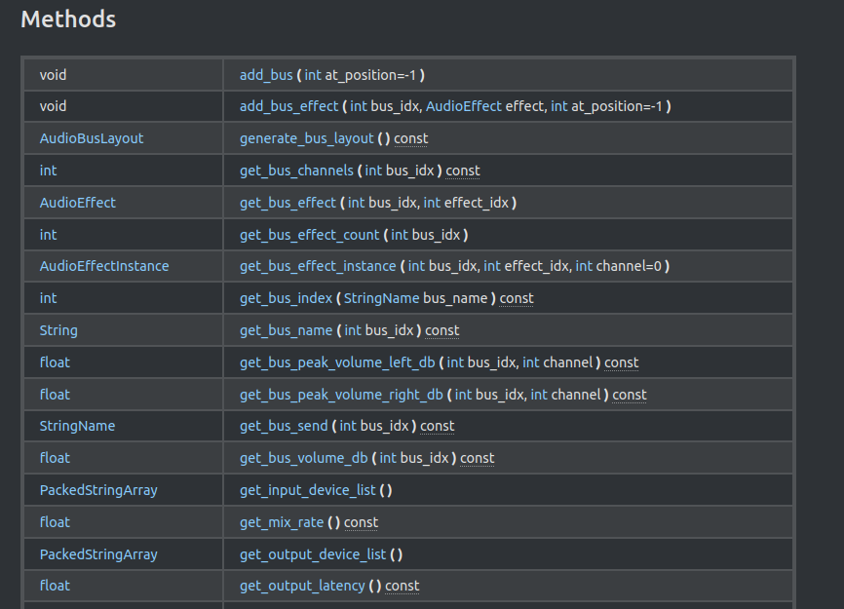
The Godot Game Engine - AudioServer Singleton
Singleton that manages all audio operations.
Plays music, sound effects, audio cues.
Provides control over audio mixing and effects.

Slide 21

Example 2 - Guava: Google Core Libraries for Java

Slide 22

What is guava?
Guava, developed by Google, is a popular Java programming library known for its versatility and utility. Key features:
Enhanced Collections: Guava enriches Java collections with advanced functionalities.
Functional Programming Tools: Guava simplifies functional programming in Java.
Concurrency Management: Guava facilitates concurrent programming with efficient utilities.
Hashing and Caching: Offers efficient hashing algorithms and caching mechanisms.
Graphs: a library for modeling graph-structured data, that is, entities and the relationships between them.

Slide 23
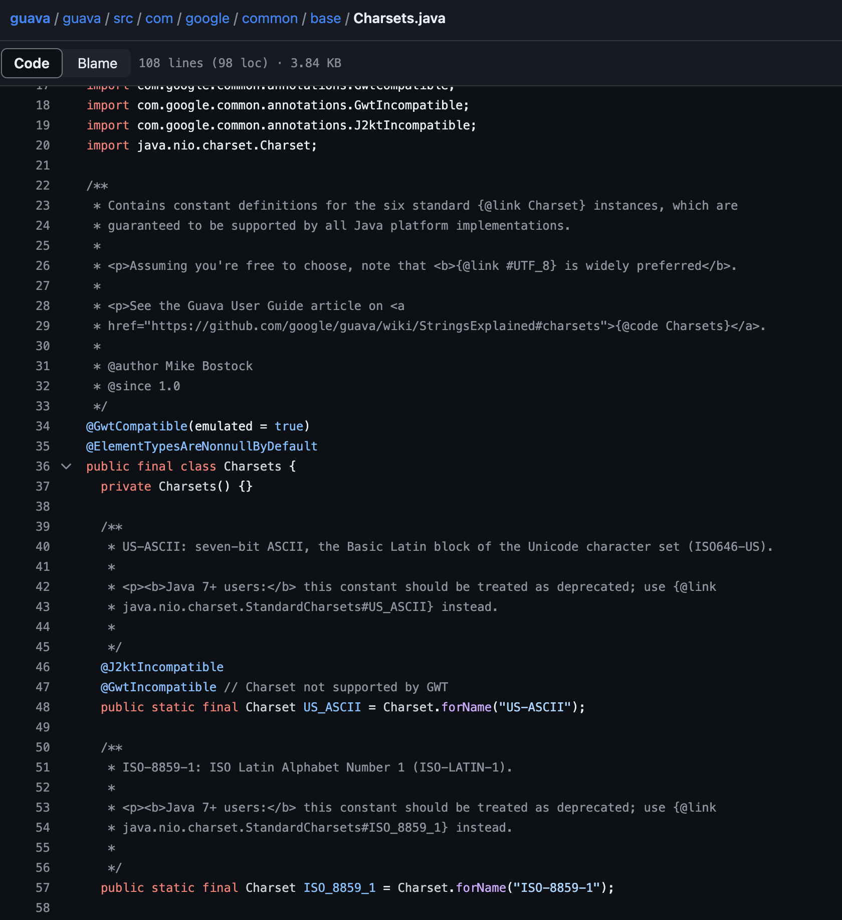
Guava Charsets.java Singleton
Charset = character set and it defines how characters are encoded and decoded
Constructor is private and every standard is initialized as static
Makes sense to be singleton because you want the charsets to be accessible in the entire application

Slide 24
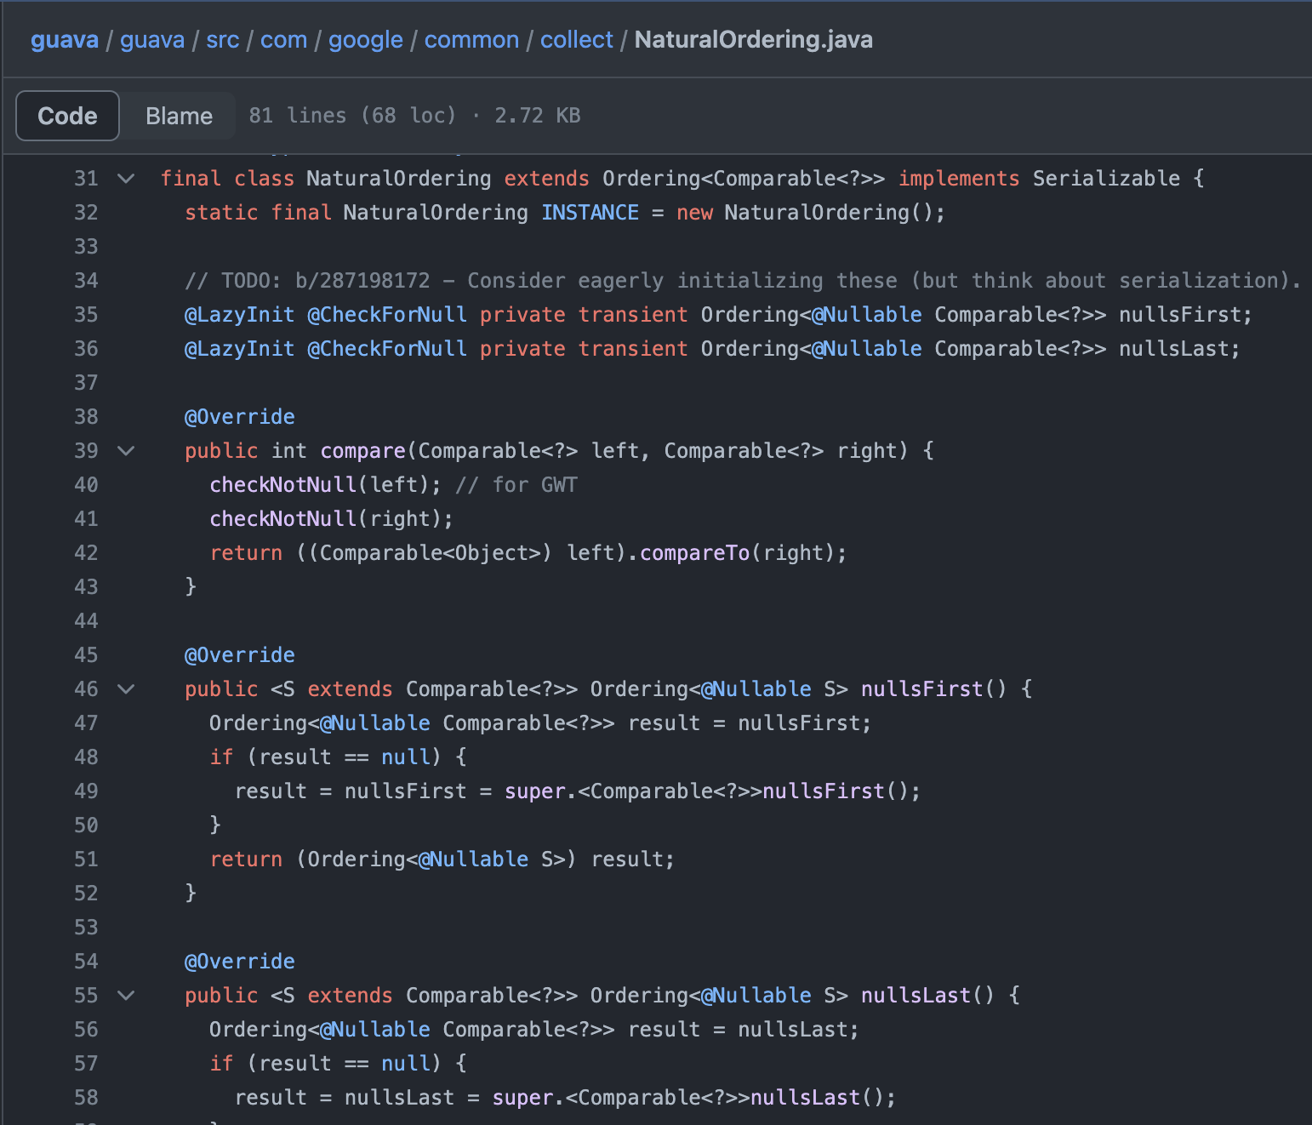
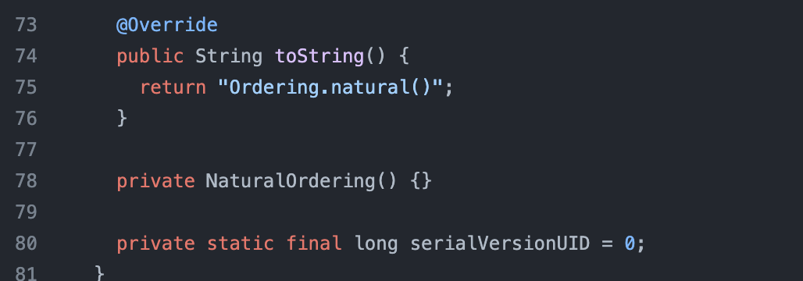
Guava Natural Ordering Singleton
is an implementation of the Ordering class provided by Guava, which defines a natural ordering for objects that implement the Comparable interface
Needs to be singleton because we can have only one natural order in the whole application

Slide 25
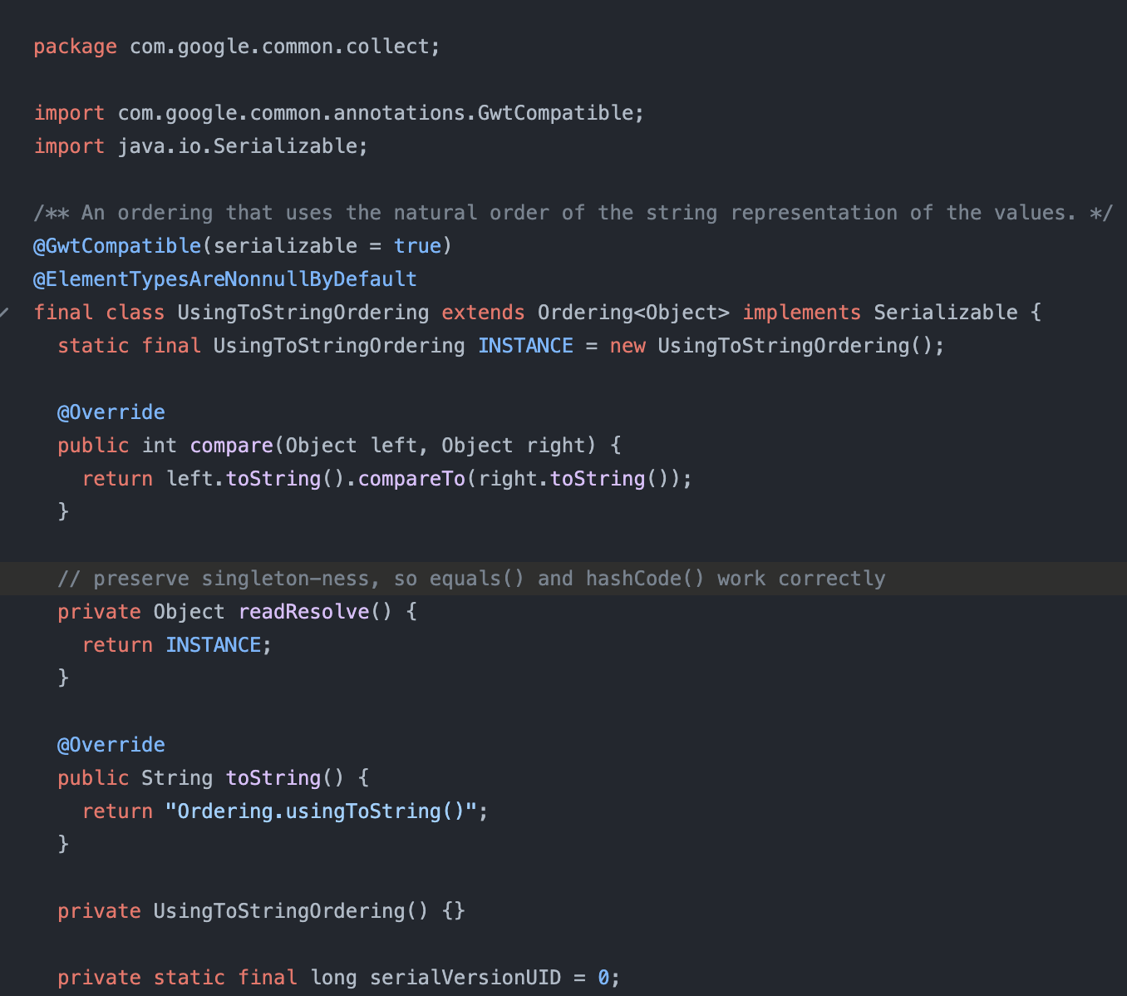
UsingToStringOrdering Singleton
Similar with the one from before, used to establish the ordering of strings through the whole application
Needs to be singleton because we can have only one string order in the whole application

Slide 26
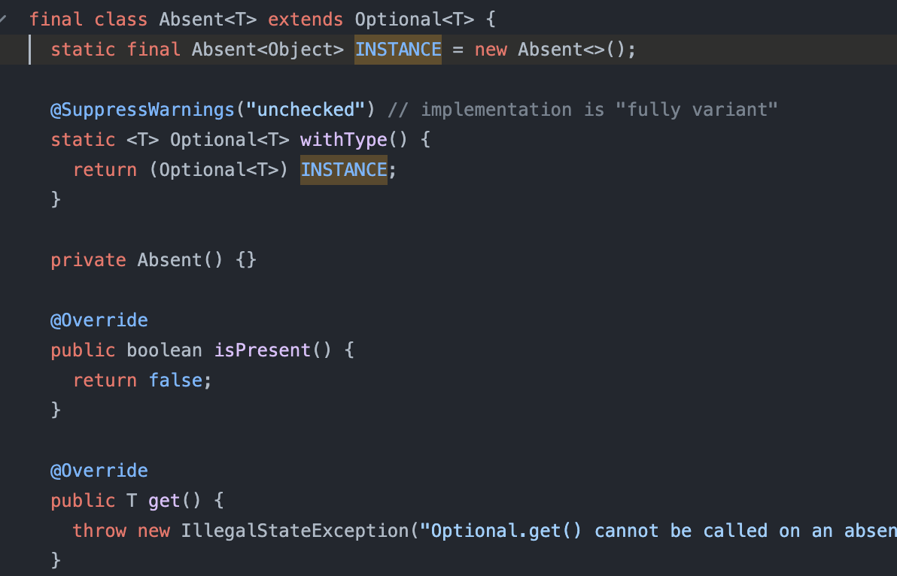
Absent Singleton
Absent is declared as a final class that extends Optional<T>, where T is the type of the value the Optional may contain.
Absent is an Optional instance not containing a reference to any value.

Slide 27
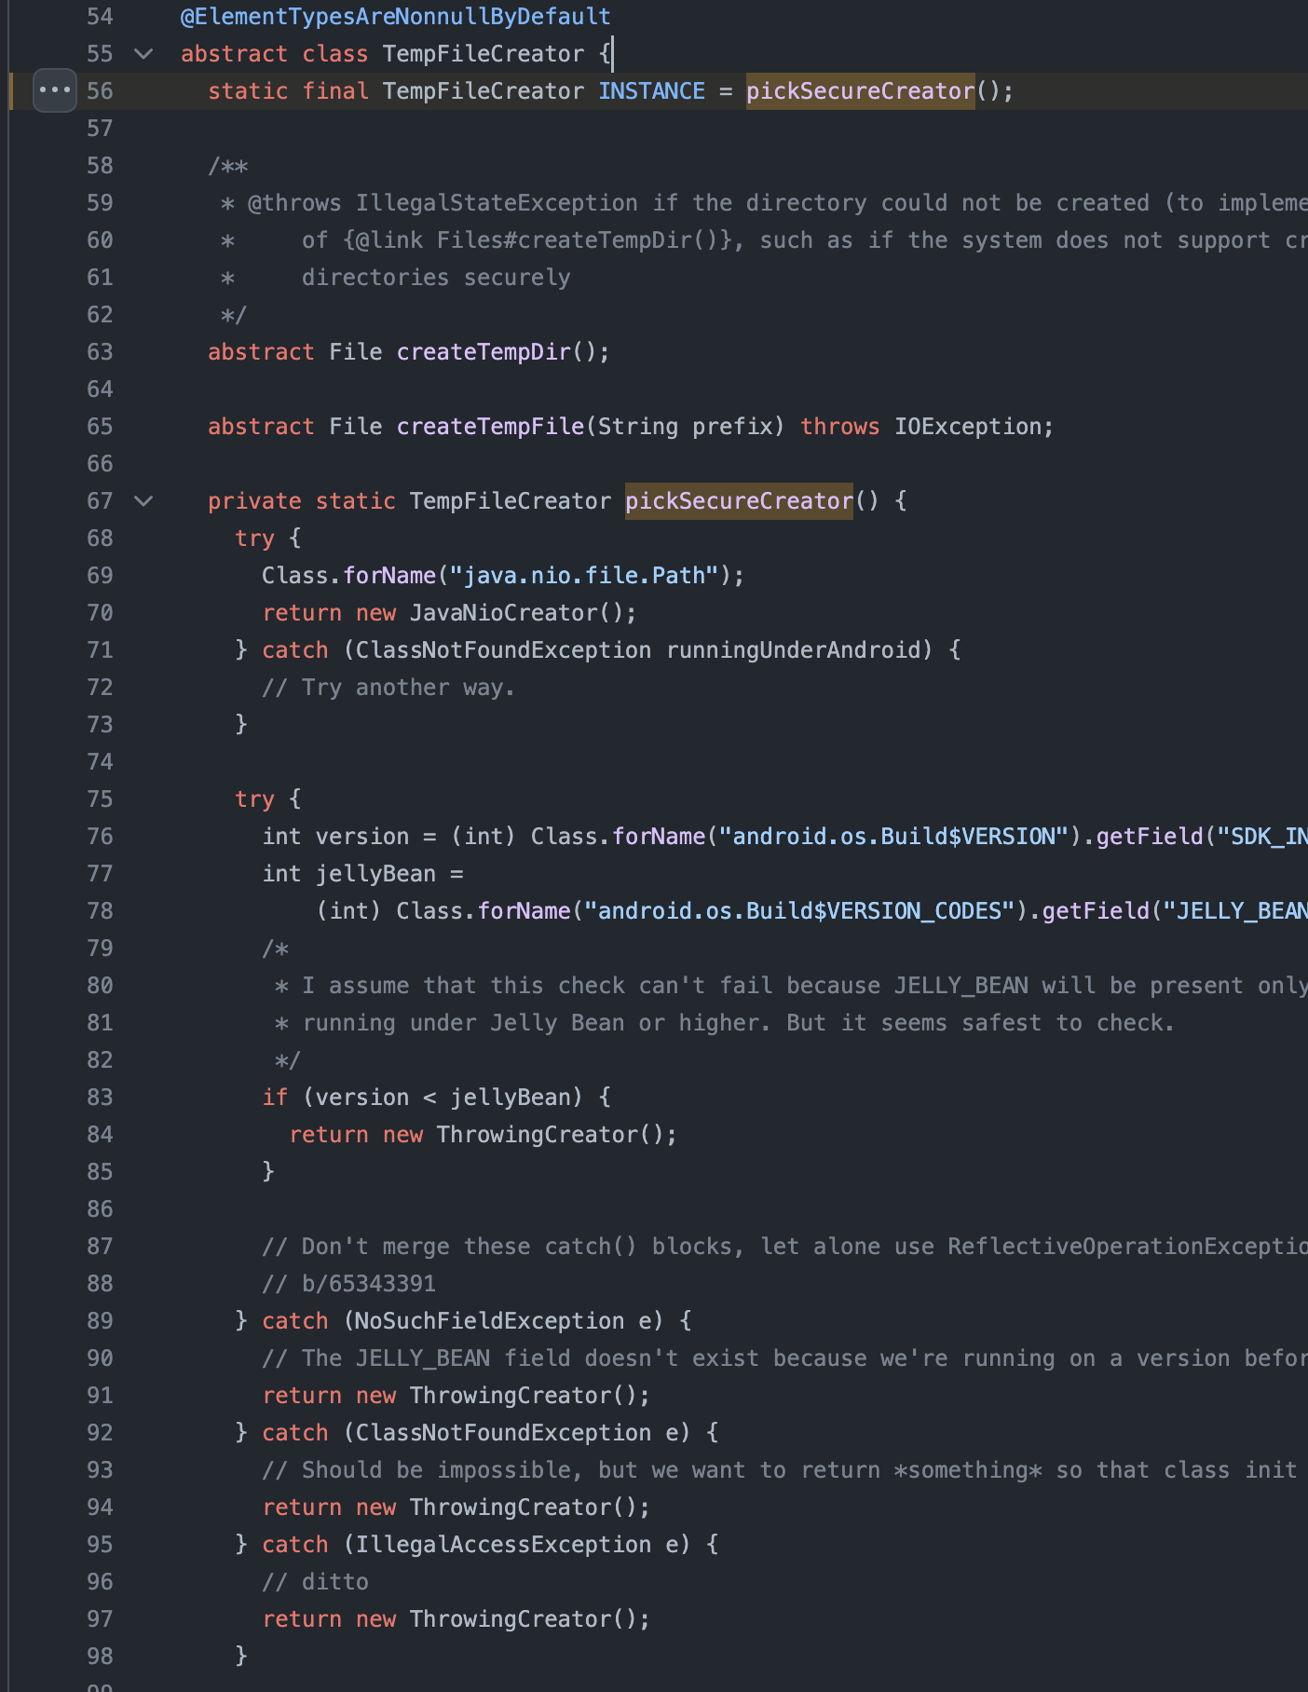
TempFileCreator Singleton
TempFileCreator class is designed to the creation of temporary files and directories in a secure manner.
It selects an appropriate implementation based on the platform it is running on and the available file system features.

Slide 28
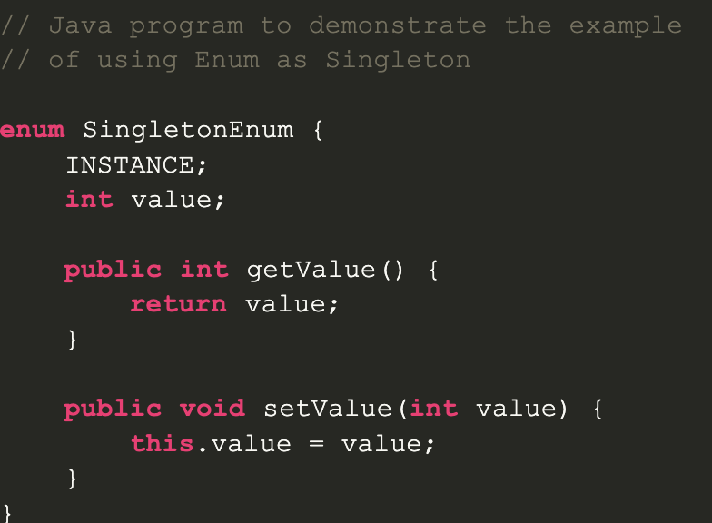
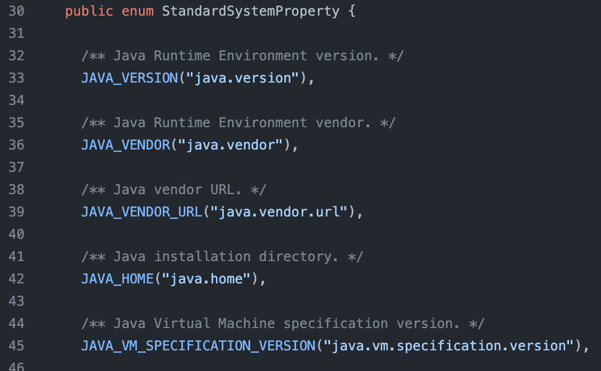
Lightweight singleton: Enum as Singleton in Java
Enums in Java are lightweight singletons because they provide a simple, efficient, and thread-safe way to implement singleton instances.
Enums are often preferred over traditional singleton implementations for several reasons such as simplicity and type safety.

Slide 29
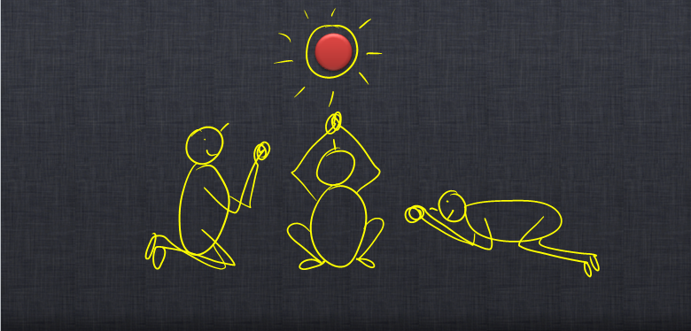
About singleton examples
Singleton is mostly considered an anti-pattern because it increases the level of coupling of the system, it is difficult to test and can lead to god-like objects.
Because of that, in Guava project a lot of singletons were present in the earlier versions of the project and were removed later.

Slide 30
References - theory
“Singleton”. Refactoring Guru, 2024, https://refactoring.guru/design-patterns/singleton

Slide 31
References - example 1
https://grep.app/search?q=singleton&filter[repo][0]=godotengine/godot, accessed 11.03.2024
https://docs.godotengine.org/, accessed 11.03.2024
https://www.researchgate.net/figure/Detailed-game-engine-architecture_fig2_323179176, accessed 11.03.2024

Slide 32
References - example 2
https://github.com/google/guava
https://www.google.com/url?sa=i&url=https%3A%2F%2Ftowardsdatascience.com%2Fintroducing-google-guava-f295d22319f7&psig=AOvVaw1fjwfPnCaaakrNiP2rBoQS&ust=1710322361428000&source=images&cd=vfe&opi=89978449&ved=0CBMQjRxqFwoTCNDVkbi17oQDFQAAAAAdAAAAABAE
https://www.google.com/url?sa=i&url=https%3A%2F%2Fengineering.99x.io%2Fsingleton-pattern-47bf15ff2f7f&psig=AOvVaw2pBwsn1btr6lKT2k-DRhPE&ust=1710276289809000&source=images&cd=vfe&opi=89978449&ved=0CBMQjRxqFwoTCLju1eeJ7YQDFQAAAAAdAAAAABAE

Slide 33
Thank you for you attention!

